Slide 1
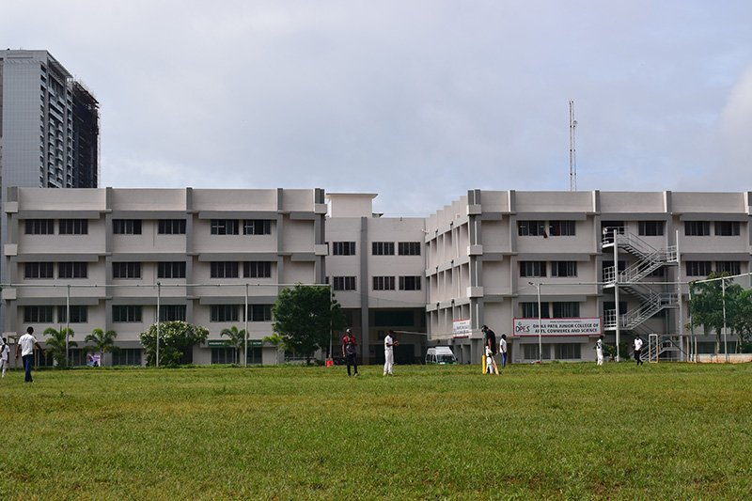


Dhole Patil College of Engineering Department of Information Technology BE Project Presentation ON ERP System for College Database Management System
BY
Mahesh Doiphode 04
Akanksha Vyavahare 42
Gauri Joshi 12
Divya Narhe 20
Guide :- Prof. Vaishali Anaspure

Slide 2
Agenda
Abstract.
Introduction.
Literature Survey.
Proposed Architecture.
System Architecture.
Software and Hardware Requirement.
Conclusion.
References.

Slide 3

Abstract
In a college there are various sections and each section handles all student information and college database. These sections are linked with each other. Current System of college is having problems of interlinking and data repetition. To overcome these problems we present College ERP System which is automated and centralized. This system have easy user interface and have powerful data management system which makes this system very useful.

Slide 4

Introduction
In recent years, institutions of higher education increasingly expand the enrollment, and it is more difficult to manage student’s data in college.
In the 21st century, information technology is an important and irreplaceable work currently in the construction of modern universities.
Exploiting Digital and informatics in universities has been attracted more and more attentions.
In general, with the increasing number of students in college, student management systems design is also important.
We propose a design for college student management system, which can play an important role in college management.
Firstly, we organize our proposed college student management ERP system i.e. Batchmates.

Slide 5
Literature Survey
Sr. No. | Paper Name | Author, Year of Publishing, Journals | Work
1. | “Human diversity in education: An integrative approach.” | Cushner, K., A. McClelland, and P. Safford. 2000. | Student–faculty interactions can be formal or informal, occurring either inside or outside instructional settings, with both playing an important role in determining students’ academic success.
2. | “The Differential Effects of Student-Faculty Interaction on College Outcomes for Women and Men Journal of College Student Development.” | Sax, Linda J., 1967-Bryant, Alyssa N.Harper, Casandra E.(2005 November) | The teachers must be aware of these social-cultural factors so that they can understand, how well the student will interact with the teacher, how well the student will interact with his or her peers, and how the student views his or her acceptance within the cultural group and within the classroom.
3. | “What Matters to Student Success: A Review of the Literature; and Light, “Making the Most of College: Students Speak Their Minds.” | Kuh et al., (2001) | This Paper identified 12 social-cultural factors. These attributes were defined based on student’s social–culture.

Slide 6

Proposed Architecture
This system changes the previous traditional ways of working, solves the inconvenience in information transfer, liberates mechanize administrators from the tedious and monotonous work, makes them convenient for the administrators to collect students’ statistics and announce information instantly. Students are able to communicate with the administrators of the student services center with low delay, giving the administrators more time to concentrating on academic guidance and living guidance.

Slide 7
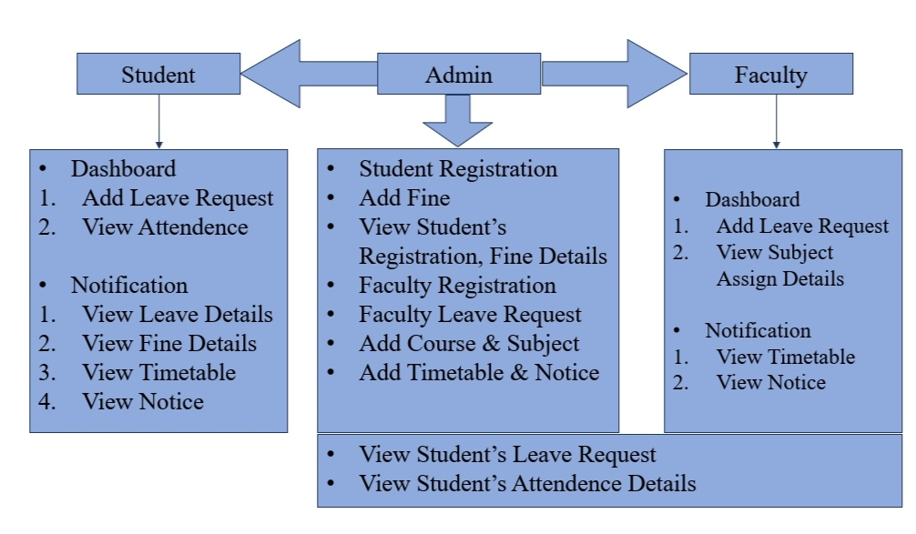

System Architecture

Slide 8
Modules :-
Admin module :-
The admin server has entire rights to the working system. Admin is the one who handles all the academic flows such as adding notice, registeration of staff & students record etc. This access is not allowed for the other users. Admin is responsible for the accountability of the college.
Student Module :-
The newly admitted students are entered in the system by the server only. When the student gets admitted the user-id and password is made by the admin which can be further changed by the student as per his/her requirements. They get access to his/her profile, subject, timetable, leave details, fine details etc.
Faculty Module :-
The Faculty members are installed by the admin and the login information is generated by the admin which is further handled by the faculty. The faculty has the entire rights to handle the data of their subjects for their respective classes.

Slide 9
Software and Hardware Requirement
Hardware Requirement :-
Processor - Intel i3/i5/i7
Speed - 3.1 GHz
RAM - 2 GB(min)
Hard Disk - 40 GB
Key Board - Standard Windows Keyboard
Mouse - Two or Three Button Mouse
Monitor - SVGA

Slide 10
Software Requirement :-
Operating System - Windows 7/8/10
Application Server - Apache Tomcat 7/8/9
Frontend - HTML, CSS, JDK 1.8, JSP, Bootstrap
Backend - Java
Scripts - JavaScript
Server side Script - Java Server Pages
Database - MySQL
IDE - Eclipse

Slide 11
Conclusion
Students Information at one place.
Management of Students and Faculties, Attendance reports.
Announcement of Notices and Events, Timetable.
Fees and Fine details of students.
Bring accountability in Staff & monitor their performance.
All decision making information at finger tips.
ERP cutdown working hours of Staff.
Increase in efficiency as process time is reduced so, Staff can utilize that time in other creative academic works.

Slide 12

References
Australasian Survey of Student Engagement (2011, September ), Ausse Research Briefing , Volume 12 2.
Stewart, E. B (2007) “ Individual and School Structural Effects on African American High School Students' academic Achievement”. The High School Journal 91.2 pp 16-34 3.
Wilson, K. M., &Trainin, G. (2008) First-Grade Students' Motivation and Achievement for Reading, Writing, and Spelling. Reading Psychology, 28(3),pp 257-282. 4.
Helena J.M. Pennings, Jan vanTartwijk, Theo Wubbelsa,,Luce C.A. Claessens, Anna C.vanderWantb, MiekeBrekelmansa (2013 July 23 ) “Real-time teacher student interactions: A Dynamic Systems Approach”, ELSEVIER Teaching and Teacher Education pp 183-193 5.
Deanne Beckwith, Lori Gee, Mark Meagher, and Scott Pobiner (2008) Enriching the Learning Experience INTEGRATING NEW TECHNOLOGIES INTO FLEXIBLE LEARNING SPACES Solution Essay / 2008.
MeeraKomarraju , segeyMusulkin, Gargi Bhattacharya (2010 May) “ Role of Student-Faculty Interactions in Developing college Student’s academic self-Concept , motivation and achievement “ Journal of May/June 2010, vol 51 No 3

Slide 13
Thank You!!!

